Slide 1
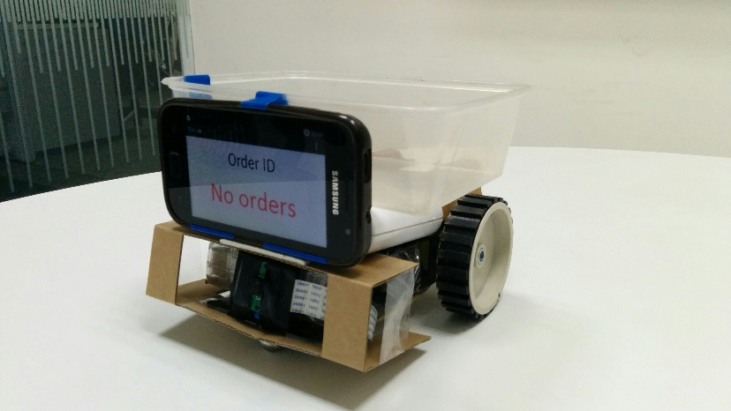
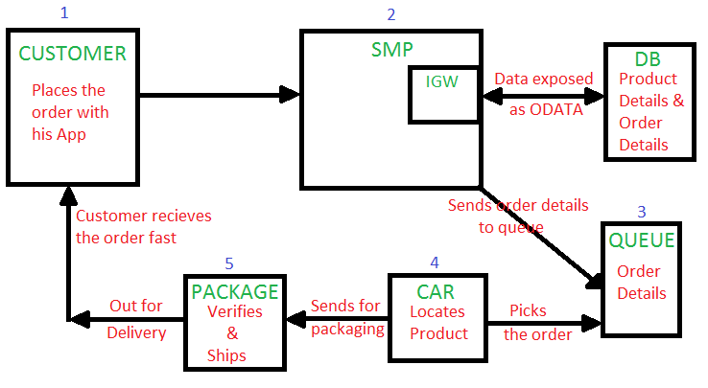
Warehouse Automation
Industry: E-commerce Team members: Manoj, Sudhansu
Automating warehouse to pick the order item and send it for shipment
To handle more orders in less time, reduce man power and errors.
Business Driver/Pain points
Lot of man power and salary for handling goods in warehouse.
More time to ship the package from warehouse during mass orders.
Human errors during shipment.
Application/Solution Benefits
Automatic location and order pickup from the queue.
More orders processed in a minute leads to faster shipping.
Less errors as everything is automatic.
Cost effective since man power is reduced.
Happy customers since ordered is processed fast.
More detailed tracking of the order.
Warehouse Automation
Picture
Solution Architecture
Faster shipping, Happy customers
Reduction in man power, faster processing of orders, detailed tracking of order, less errors.

Slide 2
Architecture
HANA Cloud Platform
HANA DB
Fetches details
Mobile
Places the order
Places the order in queue
Drops for Delivery
Raspberry Pi Robot
Order Queue
Picks up the order
Finds and travels to location of product

Slide 3
Architecture

